Slide 1
9.22 PYSINDY (the original system displayed is wrong)
AYAN DEEP HAZRA

Slide 2
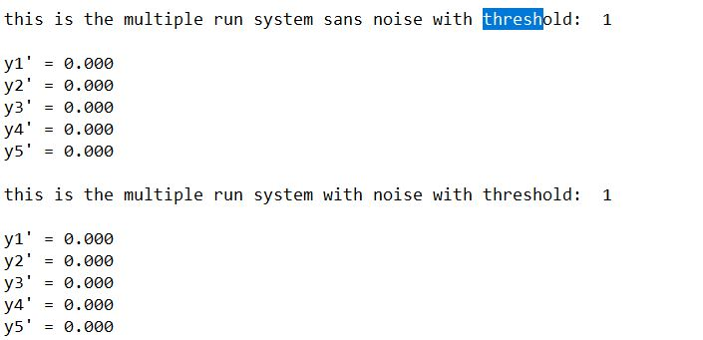
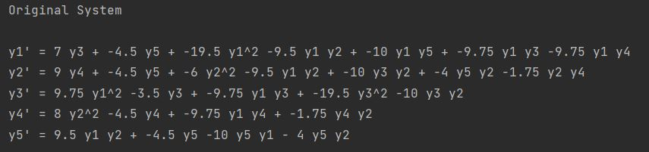
Threshold = 10^0

Slide 3
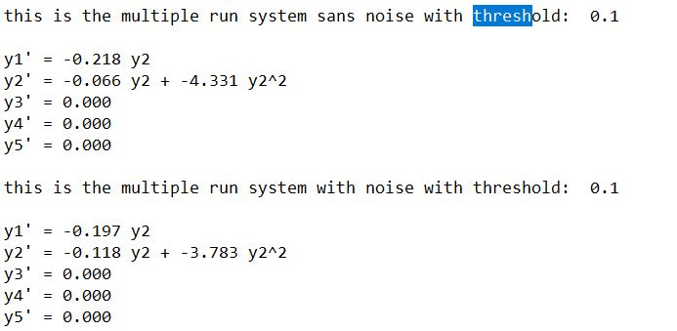
Threshold = 10^-1

Slide 4
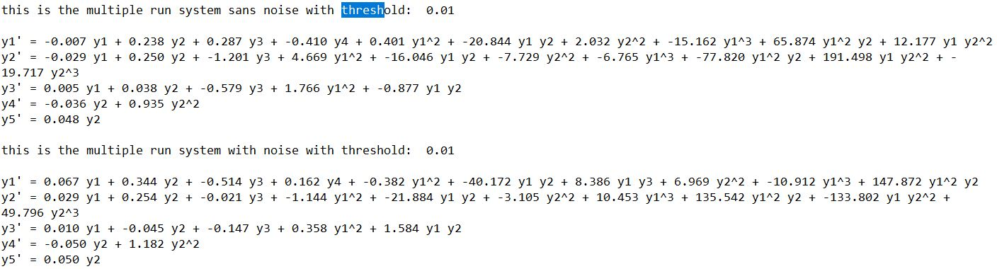
Threshold = 10^-2

Slide 5
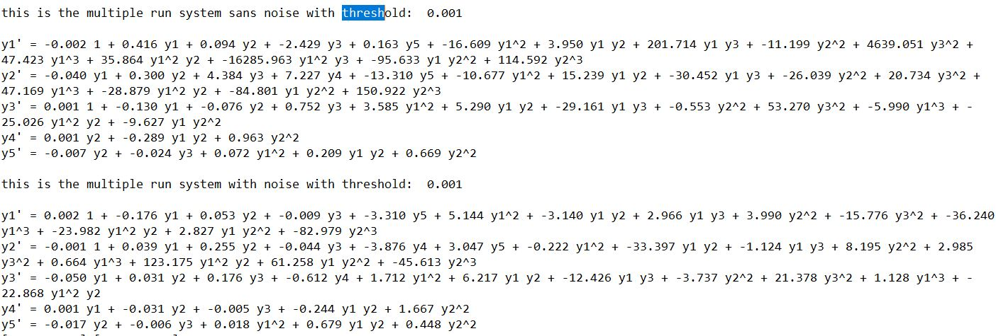
Threshold = 10^-3

Slide 6
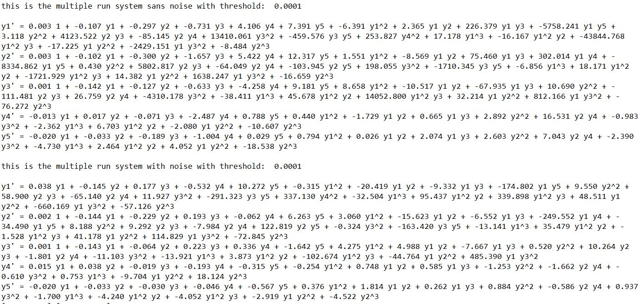
Threshold = 10^-4

Slide 7
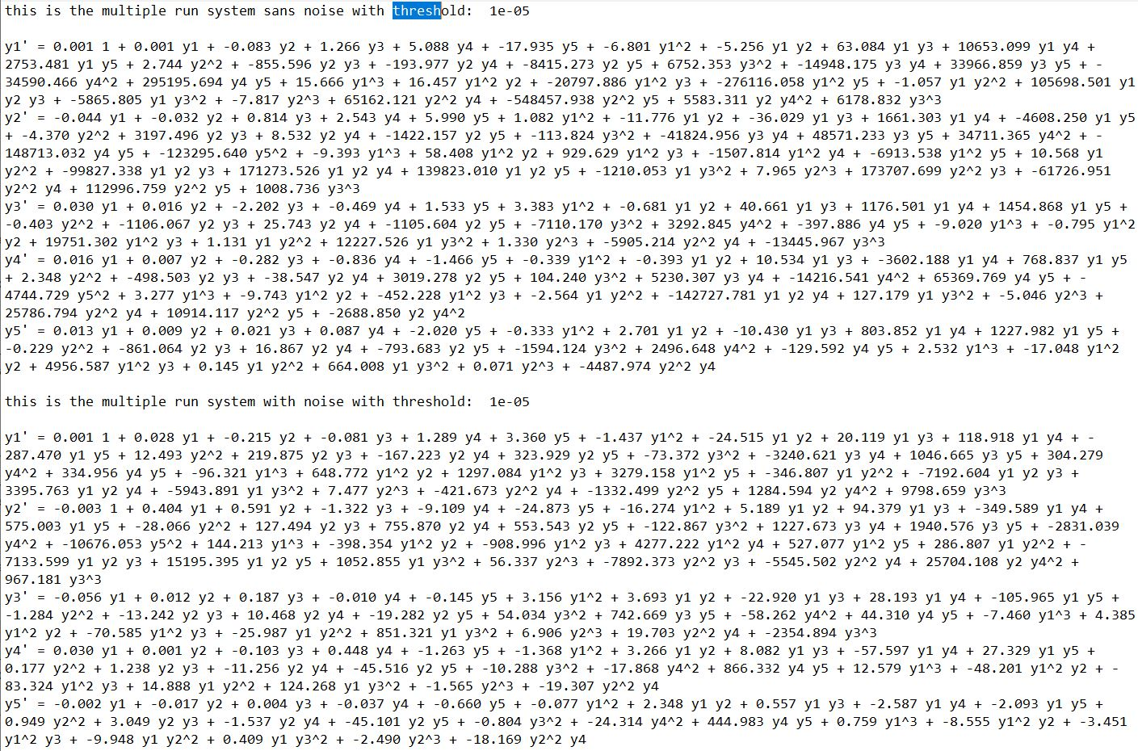
Threshold = 10^-5

Slide 8
Forward simulation
Bugs, not able to exclude negative concentrations yet
Will have to keep working on it

